Slide 1


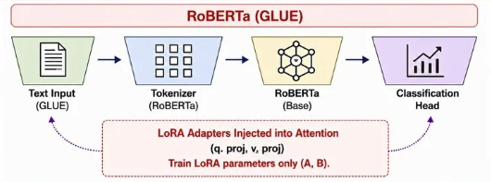
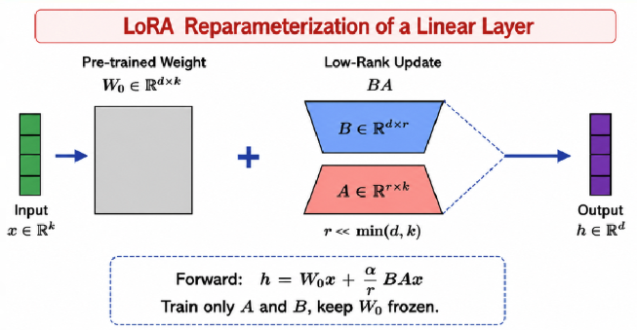
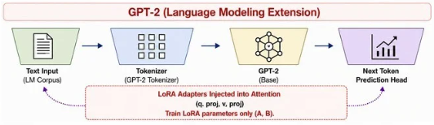
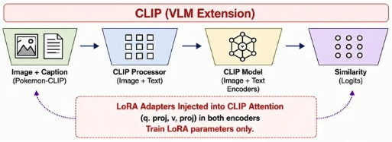
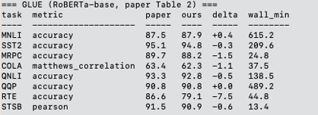
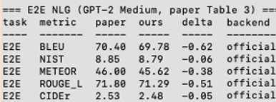
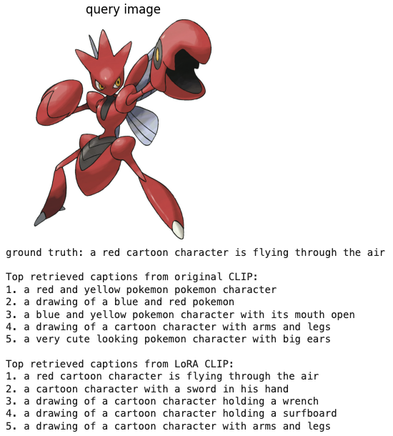
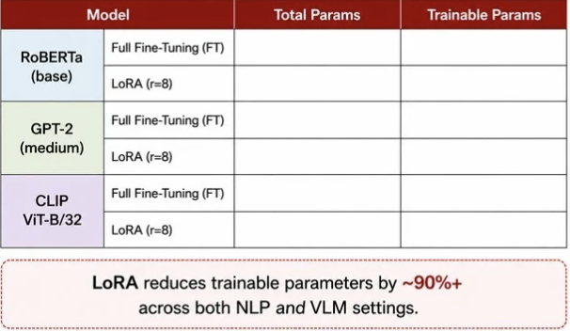
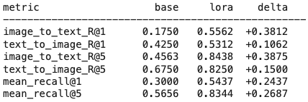

LoRA: Low Rank Adaptation of Large Language Models
Re-implemented by: Austin Lu (al2622) | Jason Chen (yc2786)
Original Authors: Hu, E. J., Shen, Y., Wallis, P., Allen-Zhu, Z., Li, Y., Wang, S., Wang, L., & Chen, W. (2021).
Github Repo
Introduction / Abstract
Methodology
Problem: Full fine-tuning of large models is expensive in parameters, memory, and storage, making task-specific adaptation costly and inconvenient to deploy at scale.
Goal: Reproduce the main claim of LoRA (Hu et al., 2021): low-rank adaptation achieves performance comparable to full fine-tuning while using far fewer trainable parameters.
What We Reproduce/Investigate:
Parameter-efficiency gains (trainable parameters, memory savings)
Downstream task performance (RoBERTa on GLUE and GPT2-Medium on )
Extension to vision-language models (CLIP) with image-text retrieval
Results
Conclusion
~125 M
~125 M (100%)
Massive Parameter Efficiency: We successfully reproduced the core claim of the original paper, achieving a ~99.7% reduction in trainable parameters across all models
Uncompromised Performance: Low-rank adaptation achieved comparable evaluation metrics to full fine-tuning across NLU (RoBERTa on GLUE) and NLG (GPT-2 on E2E)
Successful Multimodal Extension: Beyond traditional text models, we demonstrated the versatility of LoRA by successfully injecting adapters into CLIP's attention layers
~125.3 M
294,912 (~0.24%)
~355 M
~355 M (100%)
~355.8 M
786,432 (~0.22%)
~151 M
~151 M (100%)
Acknowledgements
~151.5 M
491,520 (~0.33%)
Hu, E. J., Shen, Y., Wallis, P., Allen-Zhu, Z., Li, Y., Wang, S., Wang, L., & Chen, W. (2021). LoRA: Low-Rank Adaptation of Large Language Models. arXiv. https://doi.org/10.48550/arxiv.2106.09685
Novikova, J., Dušek, O., & Rieser, V. (2017). The E2E Dataset: New Challenges For End-to-End Generation. Proceedings of the 18th Annual SIGdial Meeting on Discourse and Dialogue, 201-206. https://doi.org/10.18653/v1/w17-5525
Wang, A., Singh, A., Michael, J., Hill, F., Levy, O., & Bowman, S. (2018). GLUE: A Multi-Task Benchmark and Analysis Platform for Natural Language Understanding. Proceedings of the 2018 EMNLP Workshop BlackboxNLP: Analyzing and Interpreting Neural Networks for NLP. https://doi.org/10.18653/v1/w18-5446
LoRA reduces trainable parameters by ~99.7%+ across both NLP and VLM settings

